Slide 1
VIDEO SEMANTIC RECOGNITION
USING SPLINE REGRESSION BASED AND GRAPH BASED SEMI SUPERVISED LEARNING
Anuj Baranwal
Rohit Kumar
Siddharth Ramakrishnan

Slide 2
MOTIVATION
Curse of high dimensionality
Many irrelevant features
Feature selection
Lack of labelled data sets
Utilize data distribution or local structure or both

Slide 3
Semi Supervised Learning
Supervised Learning
Unsupervised Learning
Semi-supervised Learning : The training data consists of both labeled instances & unlabeled instances
Assumption that there is much more unlabeled data than labeled data.
The goal of semi-supervised classification is to train a classifier f from both the labeled and unlabeled
data, such that it is better than the supervised classifier trained on the labeled data alone

Slide 4
Literature Survey

Slide 5
PROBLEM STATEMENT
Given a large set of labelled and un-labelled training videos, apply semi supervised learning techniques in order to semantically categorize them.
Based on the type of data received and assumptions made on the training data, provide a comparative study of which algorithm works best under what circumstances.

Slide 6
Algorithms to be implemented
Spline Regression
Graph Based Method
Adaboost

Slide 7
OBJECTIVES
Process the key frames and generate the feature set
Apply the semi supervised algorithms on the featured data set to generate reduced feature set
Obtain results and plot graphs to determine which algorithms work well with the given data set
Varying some of the assumptions and heuristics involved, check to see whether that has an impact on the performance of a given algorithm

Slide 8
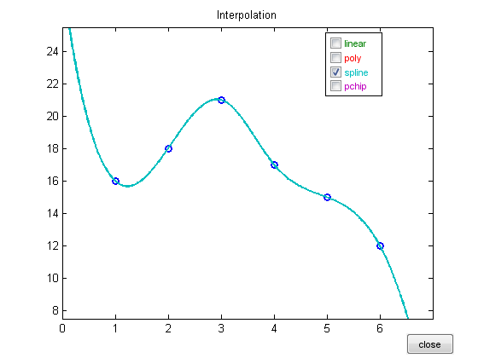
Spline Regression
Splines?

Slide 9
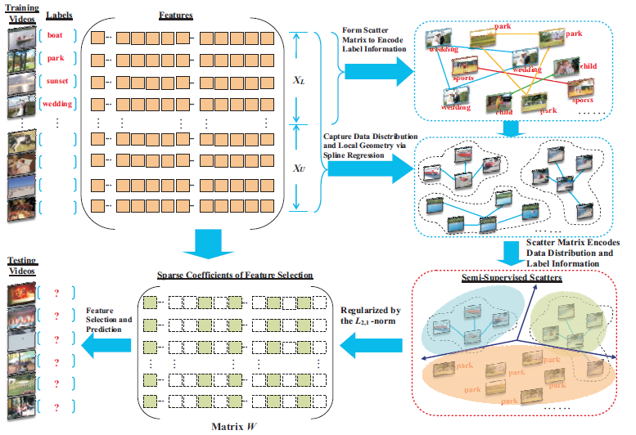
Spline Regression

Slide 10
Graph Based Method

Slide 11
Graph Based Method
efficiently search for the optimal sub graph features
containing both the labeled and the un labeled graphs.
assumption that the feature set is given, but this algorithm has the semi supervised feature selection being performed on graph data in a proceeding way together with the sub
graph feature mining process.
develop a feature evaluation criteria in order to estimate the usefulness of subgraph features based upon both the labeled graphs and the unlabeled graphs.
develop an algorithm to efficiently search for optimal subgraph features by judiciously pruning/cutting the sub graph feature space.

Slide 12
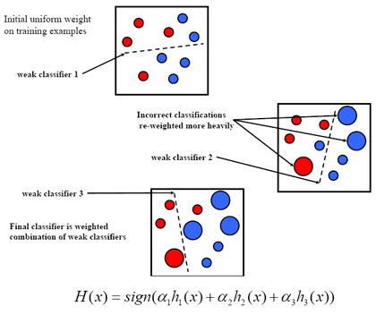
ADABOOST

Slide 13
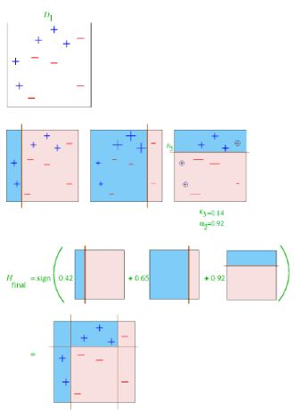
Adaboost

Slide 14
Advantages of Adaboost
It is fast, simple and easy to program.
It has no parameters to tune (except for the number of round T ).
It requires no prior knowledge about the weak learner and so can be flexibly combined with any method for finding weak hypotheses.
Finally, it comes with a set of theoretical guarantees given sufficient data and a weak learner that can reliably provide only moderately accurate weak hypotheses.
This is a shift in mind set for the learning-system designer: instead of trying to design a learning algorithm that is accurate over the entire space, we can instead focus on finding weak learning algorithms that only need to be better than random.

